Slide 1
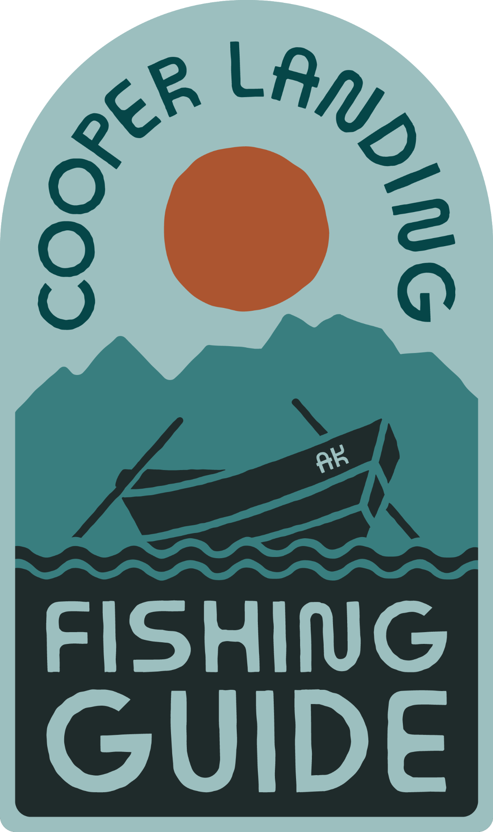
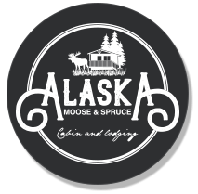

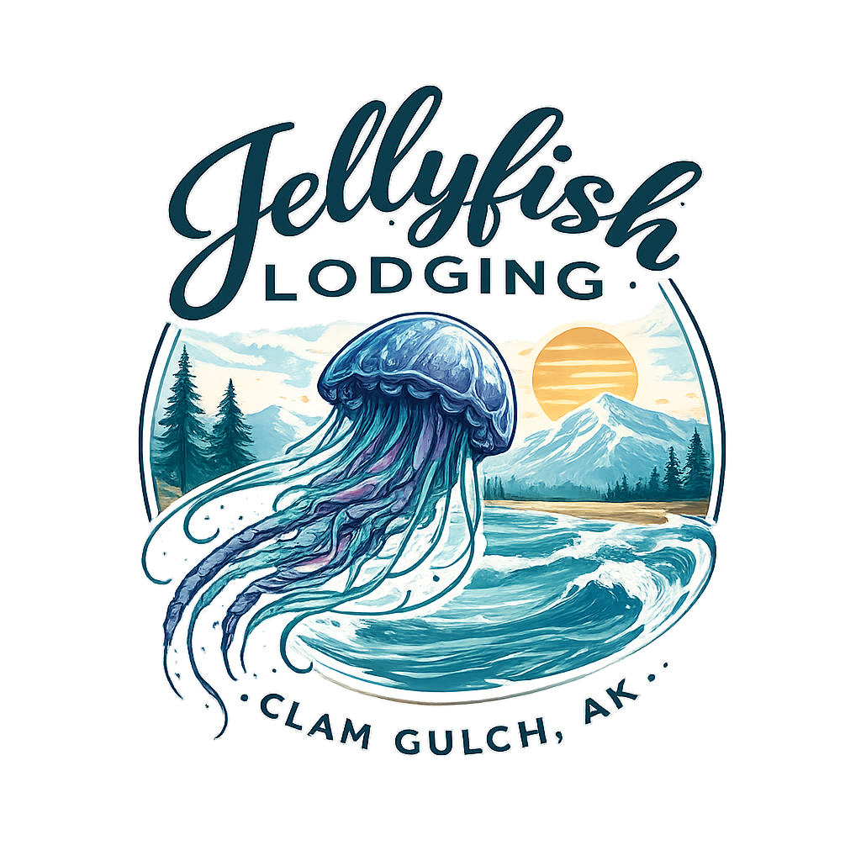

THE LAST FRONTIER
COLLECTION CLUB
Alaska's Premier Vertically Integrated Tourism & Lodging Investment
$7.5M+
20%
7%
$25K
Phase 2 NOI Target
Equity Offered
Annualized Return
Min. Investment
OUR PORTFOLIO PROPERTIES
Kenai Peninsula, Alaska | Investor Presentation 2026

Slide 2
THE PROBLEM
What problem does The Last Frontier Collection solve?
01
Fragmented Booking Experience
02
Archaic & Outdated Websites
Alaska visitors must navigate dozens of separate booking platforms for lodging, fishing guides, excursions, and transportation — leading to friction and drop-off.
Many Kenai Peninsula operators rely on outdated web infrastructure, missing mobile bookings and failing to convert high-intent traffic.
03
Operators Not Responding
04
Daunting, Confusing Itineraries
Lodge and excursion business owners frequently miss inquiries due to poor systems — guests book elsewhere or abandon plans entirely.
Visitors face complex logistics — long drives, unclear routing, and no single source of curated, end-to-end trip planning for the Kenai.

Slide 3
MARKET OPPORTUNITY
The Kenai: Alaska's Playground
~3M+
Kenai Peninsula Market Access Points
Annual Alaska Visitors
Major Cruise Ship Terminals
2
Hours from Int'l Airport (ANC)
1
30–35%
Annual Fishing Clients (Top Funnel)
4,500-5,000
Visit Kenai Peninsula
Annual Lodging Clients (AirBnb/VRBO)
1,000+
~1M
CLFG Website Traffic (2025 YTD)
92,000
Kenai Visitors Annually
AHL Lodging Traffic Growth (2025 YTD)
+32%

Slide 4
THE ECOSYSTEM
Vertically Integrated Top-of-Funnel Model
TOP OF FUNNEL
4,500–5,000 Annual Fishing Clients
Cooper Landing Fishing Guide brings high-intent, high-spend Alaska travelers into our ecosystem
LODGING CAPTURE
1,000 Annual Lodging Clients (AirBnb / VRBO)
Fishing clients funnel directly into our Kenai lodge & cabin properties
EXPERIENCE LAYER
Additional Activities, Dining & Curated Itineraries
Guests are offered guided experiences, charter tours, and excursion packages via our portfolio
ACQUISITION PIPELINE
Phase 2 — Additional Lodging & Fishing Assets
Proven funnel enables targeted M&A of underperforming Kenai properties
CAPTURE THE FULL TRAVEL ROUTE OF OUR CLIENT POOL

Slide 5
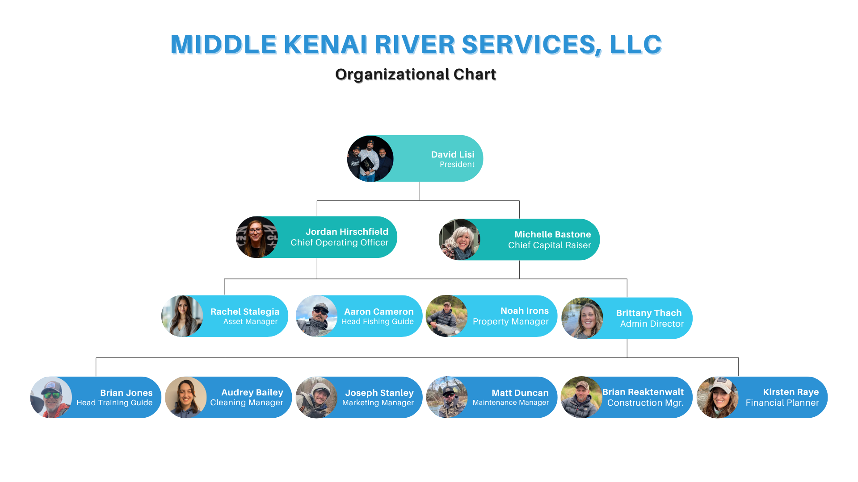
OUR TEAM
Middle Kenai River Services, LLC

Slide 6
TRACTION
Proof of Concept — Real Numbers, Real Results
2024 ACTUAL
2025 ACTUAL
2026 PROJECTED
(No Changes)
$971K
$1.05M
$1.2M
$250K Profit
$300K Profit
$360K Profit
PHASE 1 — 2026 PROJECTION
PHASE 2 — GROWTH PROJECTION
▸ NOI: $470,000
▸ NOI Target: $7,500,000
▸ 30% Profit / 28% Cash-on-Cash Return
▸ Lodging & Fishing Acquisitions
▸ $104,000 Debt Savings
▸ Expanded Kenai Peninsula Footprint
▸ Asset Value: $4,375,000
▸ Full Ecosystem Realized
Website Traction: AHL Lodging — 22,482 visitors (2025 YTD, +32%) · CLFG Fishing — 92,000 visitors (2025 YTD)

Slide 7
INVESTMENT OPPORTUNITY
Club Profile & Criteria
Investment Type
Geography
Real Estate + Operating Business (Tourism/Lodging)
Kenai Peninsula, Alaska
Target Asset Value
Revenue Model
$4,375,000 (Phase 1)
Vertically Integrated: Fishing + Lodging + Experiences
Investor Profile
Timeline
Accredited investors seeking cash-flowing Alaska real estate
2-Year Investment Horizon (Acquisitions, Debt Conversion & Executive Hires)

Slide 8
USE OF FUNDS
Phase 1 Capital Allocation — $1,630,000 Target Raise
Refi Interest-Only Debt (Blakley Ct.)
$800,000
49% of raise
Debt Conversion — Blakley Ct.
$300,000
18% of raise
Debt Conversion — Brenda Way
$180,000
11% of raise
Purchase Jellyfish Ave Property
$200,000
12% of raise
Executive/Admin Hire & Holding Costs
$150,000
9% of raise
TOTAL RAISE TARGET: $1,630,000 · Minimum Raise: $500,000 · Minimum Investment: $25,000

Slide 9
THE ASK
Phase 1 — Raising $1,630,000 ($500K Minimum)
$800K
Refi Interest-Only Debt
$180K
Debt Conversion
Blakley Ct. — convert $1M debt to 1st position security
Brenda Way Property — strengthen balance sheet
$300K
Debt Conversion
$150K
Executive / Admin Hire
Blakley Ct. Property — eliminate liability, increase equity
Senior hire + holding costs, TC fees, capitalize LLC
$200K
New Property Purchase
Jellyfish Ave — strategic acquisition for inventory expansion

Slide 10
COMPETITIVE ADVANTAGE
Why The Last Frontier Collection vs. Traditional Alaska Operators
01
Vertical Integration
02
Established Local Presence
Own the full client journey — from first fishing inquiry to multi-night lodge stay and excursions. No competitor controls this full stack on the Kenai.
10 years of boots-on-the-ground operations in Cooper Landing. Deep relationships with local vendors, guides, and municipal partners.
03
Proven Top-of-Funnel
04
Asset-Backed Returns
92,000+ annual website visitors to CLFG fishing alone. This owned audience is a durable, low-cost acquisition channel unavailable to new entrants.
Investor capital secured by real estate equity. Returns backed by operating business income AND appreciating Kenai property values.
05
Fragmented Market = Opportunity
06
Scalable Acquisition Playbook
The Alaska small lodge market is highly fragmented with no dominant brand. First-mover advantage for a tech-forward, vertically integrated operator.
Phase 2 leverages the proven Phase 1 model to acquire underperforming properties using our client base as a ready-made revenue engine.

Slide 11
RISK MITIGATION
How we protect investor capital
RISK FACTOR
MITIGATION STRATEGY
SEVERITY
Seasonality Risk
Kenai fishing and lodging demand peaks May–September. Mitigated by multi-season programming (winter rentals, off-season group bookings) and lean fixed-cost structure.
Medium
Single-Market Concentration
Phase 2 expands to adjacent Kenai markets. Phase 1 uses diversified revenue streams (fishing + lodging + excursions) across multiple properties.
Medium
Key-Person Dependency
Phase 1 funds executive/admin hire explicitly to reduce founder dependency. Systems and operations being codified to support scale.
Low
Real Estate Value Decline
Kenai Peninsula property values supported by limited supply and increasing Alaska tourism trends. Properties also generate operating income independent of sale value.
Low

Slide 12
INVESTMENT TERMS & NEXT STEPS
Last Frontier Collection Club — Phase 1
Minimum Investment
Minimum Raise
Targeted Raise
$25,000
$500,000
$1,630,000
Equity Offered
Annualized Return
Investment Timeline
20%
7%
2 Years
NEXT STEPS
01 Review full operating financials & property portfolio documents
02 Schedule a call with founding team for Q&A
03 Complete investor accreditation verification
04 Execute subscription agreement & wire funds
Contact: askkeywestkate@gmail.com

